Slide 1
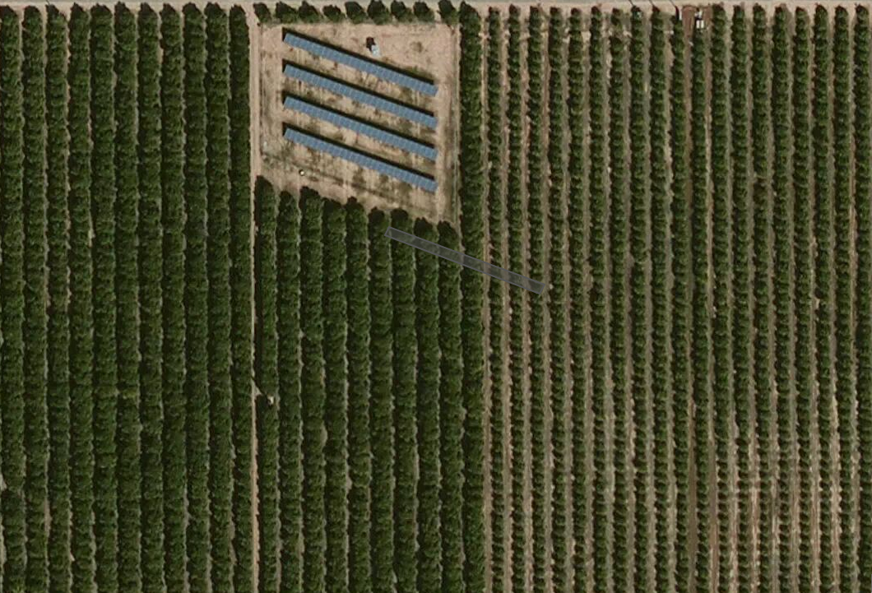
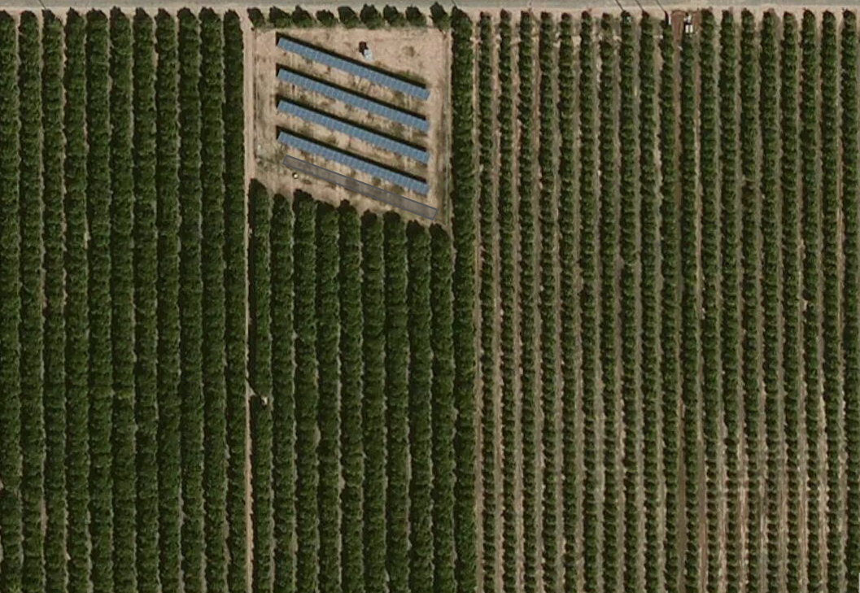
Test 1: 11ska460890
Original detection
Corrected with UTM coordinates script

Slide 2
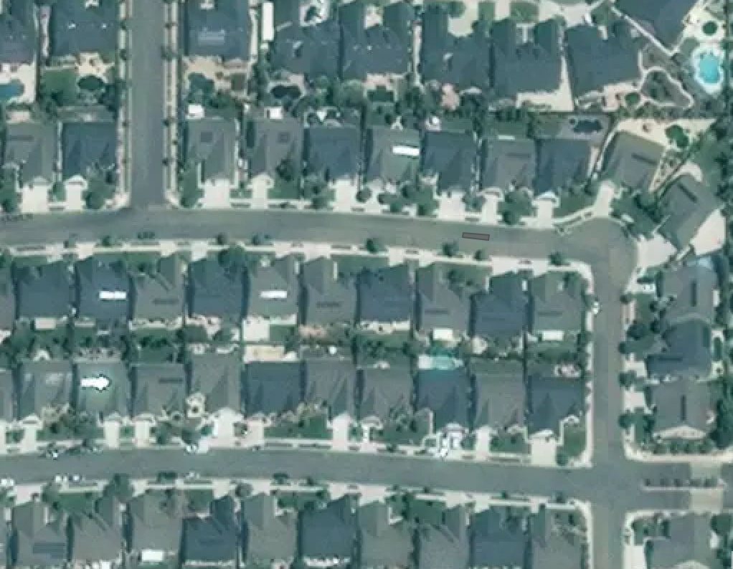
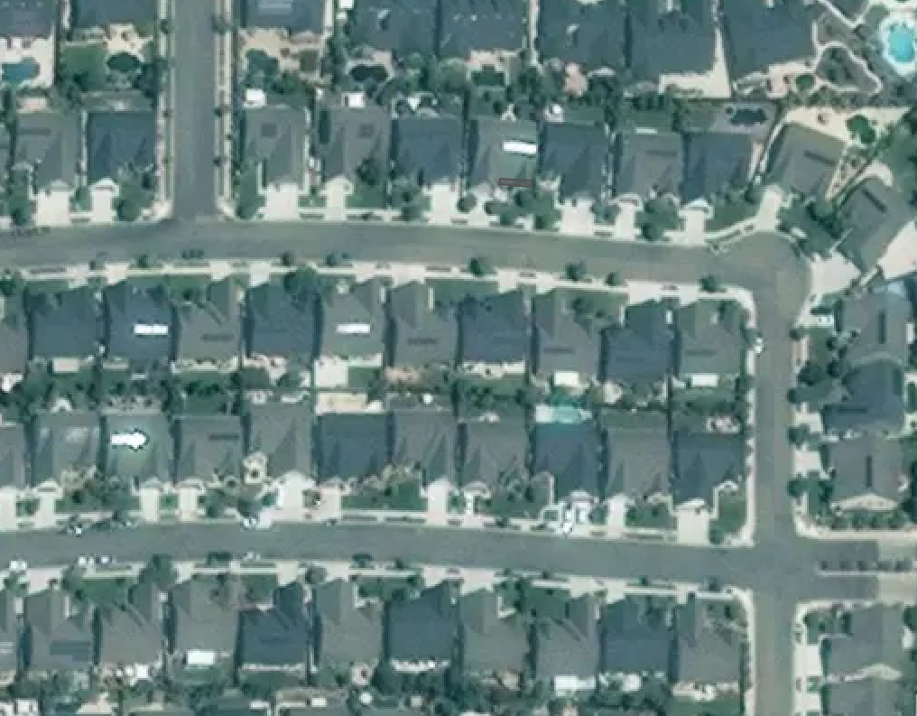
Test 2: 11ska565815
Original detection
Corrected with UTM coordinates script

Slide 3
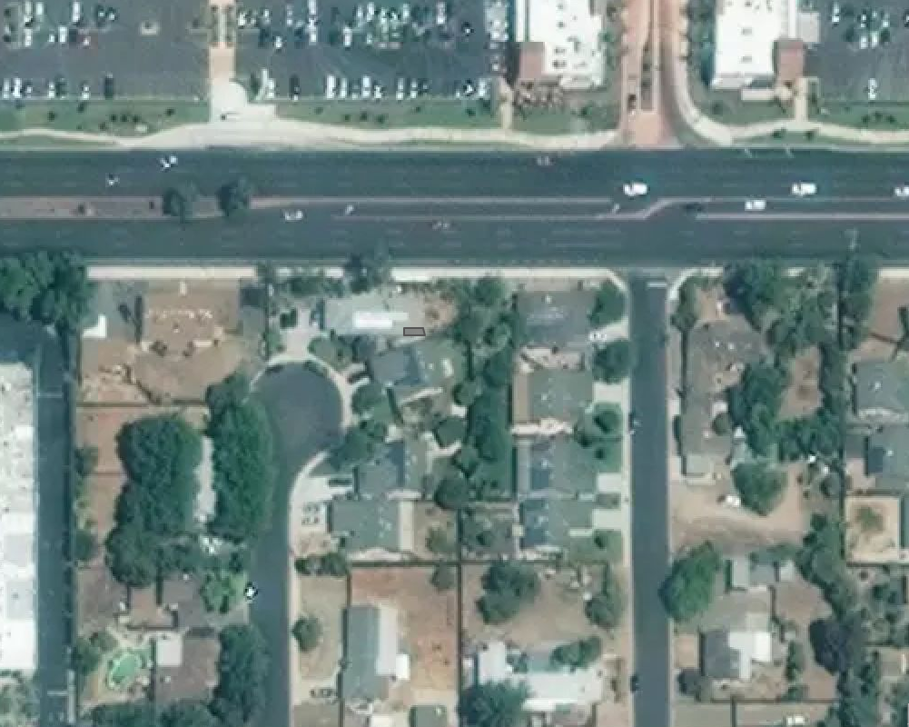

Test 3: 11ska595800
Original detection
Corrected with UTM coordinates script

